Slide 1
Ashlawn School
Sixth Form
Welcome Pack

Slide 2
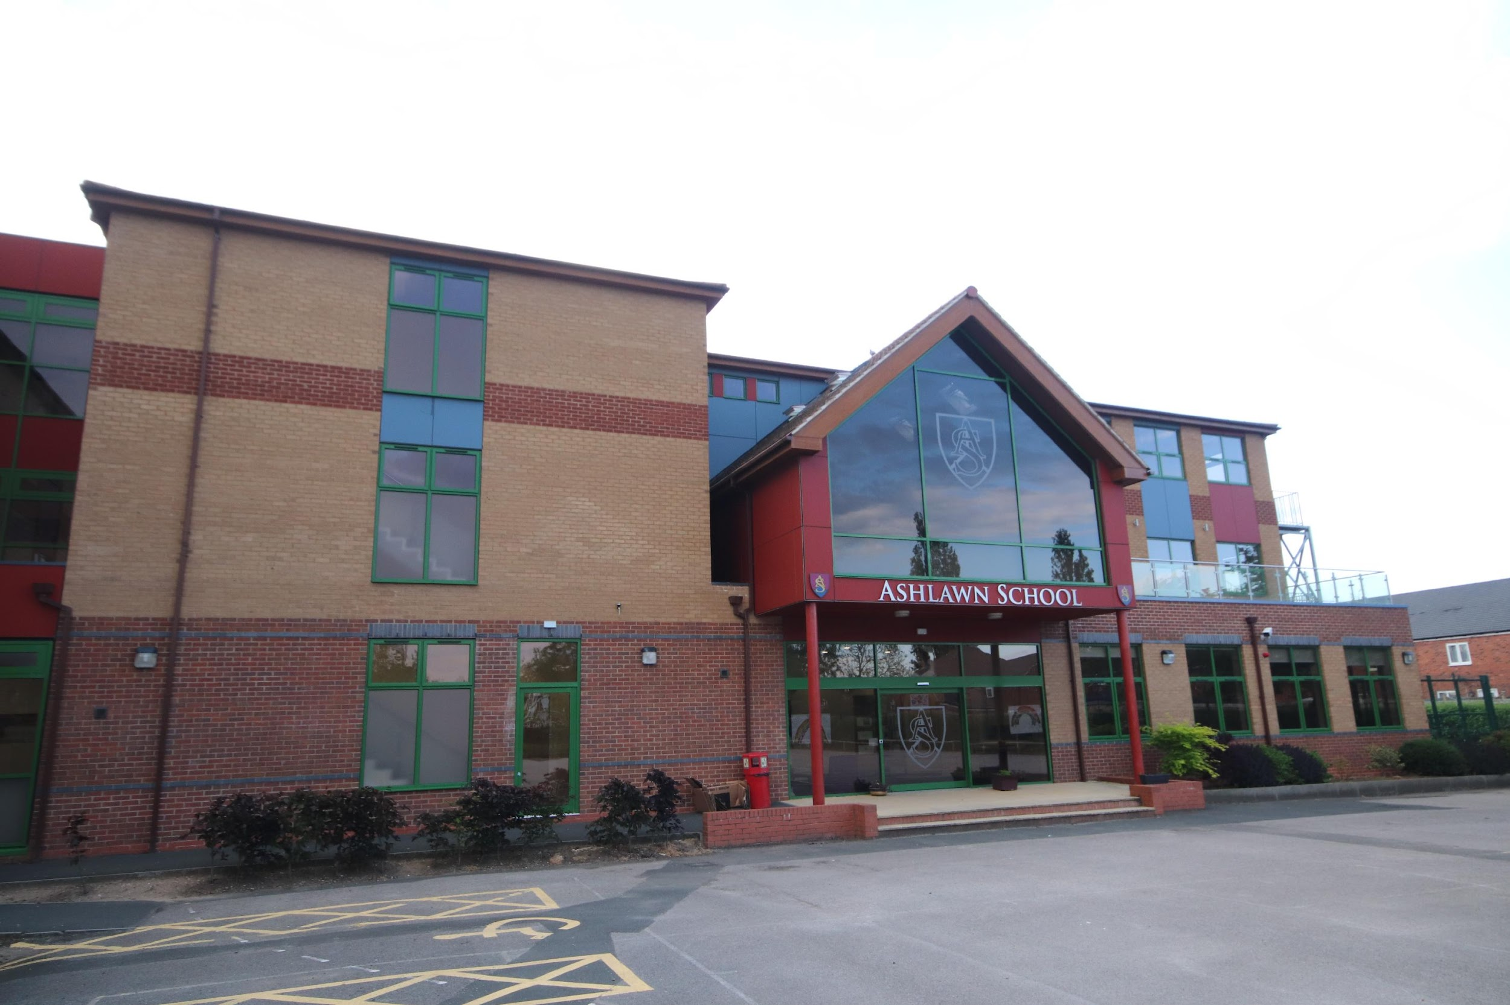
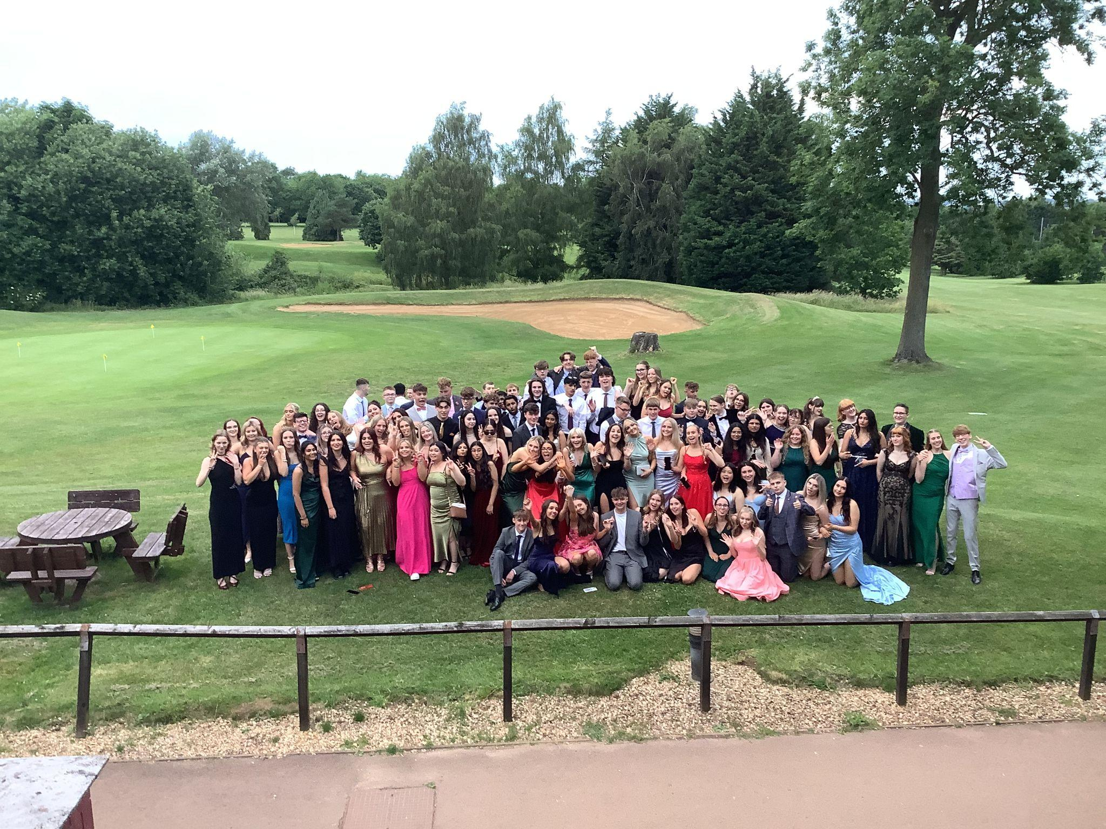
WELCOME
Ashlawn
Sixth Form
A warm welcome to all students who are joining us at Ashlawn Sixth Form this September.
We hope that this welcome pack will give you key information about what to expect from this next stage in your education.
We believe very strongly in providing every student with the support and opportunity to excel in many aspects of school life as well as to prepare you for your post-18 destinations.
We hope you will embrace the challenge ahead and we look forward to you joining us in September.
Ashlawn Sixth Form
Class of 2023
Ashlawn Sixth Form – Support and Opportunity

Slide 3
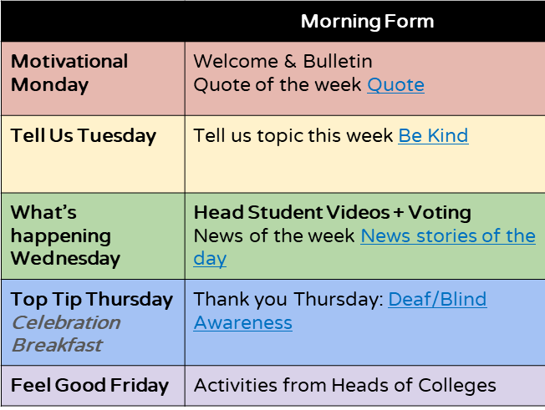
The School Day
A typical school day consists of morning form time, followed by five lessons, timetabled around morning break and lunch, as follows:
Time | 8:45 – 9:05 | 9:10 – 10:10 | 10:15 – 11:15 | 11:15 – 11:30 | 11:35 – 12:35 | 12:35- 13:15 | 13:15 – 14:15 | 14:20 – 15:20
Activity | Tutor time | Lesson 1 | Lesson 2 | Break | Lesson 3 | Lunch | Lesson 4 | Lesson 5
Each student has five lessons per subject per week, which means that most students have 15 hours of ‘contact time’ with their teachers in the school week and 10 hours of ‘non-contact study’ time. Extended Project is an additional two hours of contact time for students choosing this as an additional option.
Non-contact study time consists of three timetabled ‘supported study’ sessions in the Sixth Form Study Hub, and the remainder as ‘independent study’ lessons in which students can choose where they work.
Form time lasts for 20 minutes each day. During this time, students catch up with their form tutor and take part in a variety of activities. Some of these are relating to personal and academic development, some are tutor group tasks and activities. Activities might also include debates, creative projects or the weekly quiz.
There is also a heavy emphasis on wellbeing and mindfulness to balance the mental demands of sixth form.
Below is an example of what may happen during form time in a typical week.
Ashlawn Sixth Form – Support and Opportunity

Slide 4
Sixth Form Timeline
Post-18 Destinations
The following timeline highlights some of the key events that take place during your two years of sixth form. It’s by no means an exhaustive list as there is so much to squeeze in to a short time but this will give you an idea of what might be coming up…
Aug
RESULTS DAY
Aug
UCAS Clearing opens
June
Exams Finish
Year 13 Prom
May/ June
Study Leave and exams begin
Post-18 Destinations
March/April
A-level course content finished
May
Confirm UCAS choices
Aug
RESULTS DAY
Aug
UCAS Clearing opens
Feb
Mocks 2, Year 13 Parents’ Consultation
Jan
UCAS Deadline, mock interviews
June
Exams Finish
Year 13 Prom
May/ June
Study Leave and exams begin
Oct
Year 13 Mocks 1,
Early UCAS Deadline
Nov
Apprenticeships advertised
March/April
A-level course content finished
May
Confirm UCAS choices
Sept
Year 13 Begins,
UCAS Continues
Y13
Jun
Year 12 Exams, UCAS 1st draft in
Feb
Mocks 2, Year 13 Parents’ Consultation
Jan
UCAS Deadline, mock interviews
May
Jun
UCAS and Post-18 applications begin
Oct
Year 13 Mocks 1,
Early UCAS Deadline
Nov
Apprenticeships advertised
Assessment Week 4
Sept
Year 13 Begins,
UCAS Continues
Y13
Jun
Year 12 Exams, UCAS 1st draft in
Mar
Y12 Parents’ Consultation
Assessment Week 3
Feb
Work Experience
Jan
Year 12 Assessment Week 2
Jan
BTEC External Exams for some
Apr
Assessment Week 4
May
UCAS and Post-18 applications begin
Nov
Year 12 GCSE Resits
Nov
Year 12 Assessment Week 1
Feb
Year 12 Parents Consultation
Feb
Assessment Week 3
Work Experience
Y12
Begins
Sept
Year 12 Induction Program Begins
Sept
Year 12 Options Finalised
Dec
Year 12 Assessment Week 2
Jan
BTEC External Exams for some
Y12
Begins
Nov
Year 12 GCSE Resits
Oct
Year 12 Assessment Week 1
Sept
Year 12 Induction Program Begins
Sept
Year 12 Options Finalised
Ashlawn Sixth Form – Support and Opportunity

Slide 5
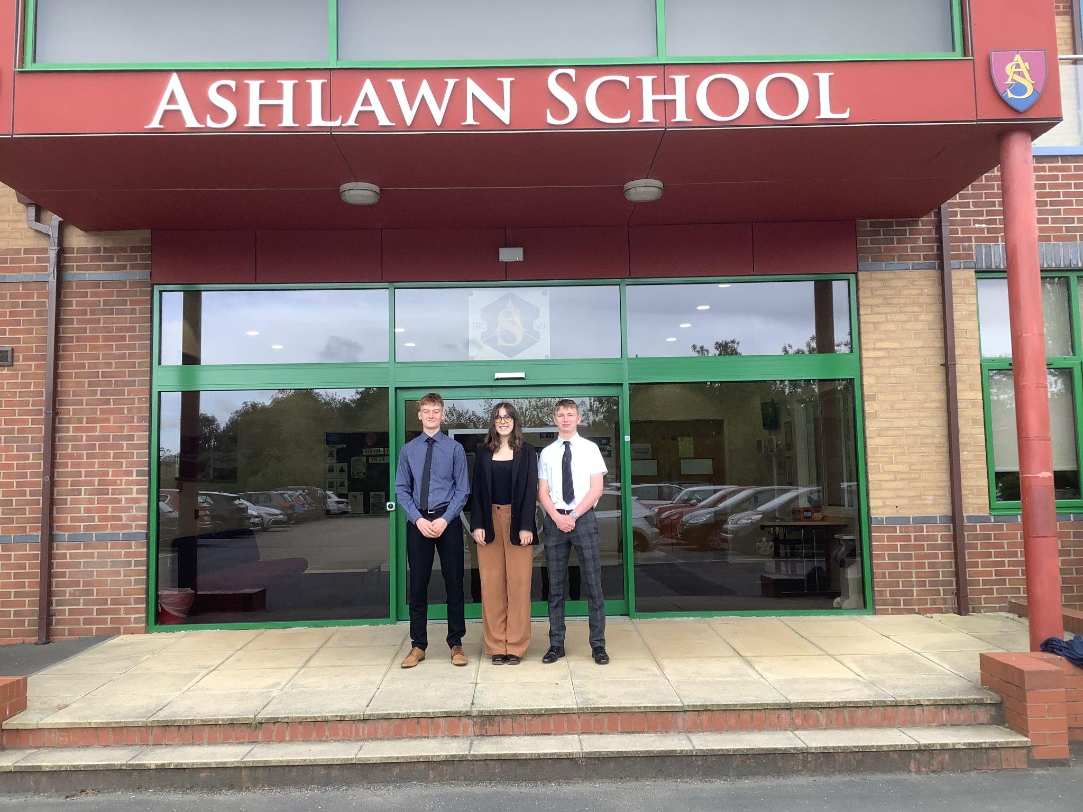
What our students have to say:
We asked some of our head students to say a few words about Sixth Form at Ashlawn and suggest their top tips.
“
Be organised from the start of Year 12 and revise topics as you go from the start…
”
Be organised from the start of Year 12…
“
”
Take subjects that you are good at and passionate about…
“
”
Get involved in leadership opportunities…
“
”
Make the most of extracurricular opportunities…
Ashlawn Sixth Form – Support and Opportunity

Slide 6
Support and Academic Wellbeing
Wellbeing is paramount in a student’s learning experience. We all face difficult moments and so student support is one of the key pillars of Ashlawn Sixth Form.
This can present itself in a variety of ways and all students are encouraged to be open about any issues they are facing so that they can be signposted to receive the appropriate intervention. Here are some of the key areas of support we provide.
School Staff Support
Form Tutor
The form tutor has a crucial role with the school and as a first contact for students. Your form tutor will see you everyday, checking in on your wellbeing, workload and life in general. Form tutors will also monitor your attendance and liaise with your subject teachers and the Sixth Form Team if necessary.
Welfare and Behavioural support
We have a Welfare lead who works within the Sixth Form Team to support students in a variety of ways. They monitor student attendance to identify any potential issues and work with students who may need additional support; either academically or in terms of their wellbeing.
Head of Year
Your Head of Year is a key figure in your time at Ashlawn. Your Head of Year will monitor your overall academic progress, your attendance, and your wellbeing. They will offer support in a number of different ways should you need it as well as well as staying in contact with your parents / carers as appropriate. As well as your form tutor, they will get to know you and give you opportunities to develop and reach your full potential.
Learning Coach
In the Study Hub, we have a Learning Coach, Miss Willis, who will support and guide you to develop good study habits. Miss Willis’s role is key to you becoming an effective learner; a student who makes the most of their supported and independent study sessions.
Subject Teachers
For academic issues, your class teacher will usually be the best person to speak. However staff from within specific departments will be happy to help if your teacher is not available and Heads of Department will also arrange targeted intervention for students who need it.
Ashlawn Sixth Form – Support and Opportunity

Slide 7
Support and Academic Wellbeing Continued…
Additional Support
External Agencies
We work with a variety of external agencies who provide intervention for students on a range of mental health issues. Sixth form students at are a transitional age with regards to this type of support but we have had positive outcomes for a lot of students with a variety of external support and can point you in the right direction.
Peer Supporters Programme
A course run by our own wellbeing team. Interested students can train up to be peer supporters and work directly with younger students to help them with wellbeing concerns when talking to an adult seems difficult.
Local Employers and Businesses
We link up with local employers and Businesses to run mock interviews with you to practise your interview techniques and give you feedback to help you prepare anf be successful at apprenticeship and university interviews.
Driving Awareness programme
We link up with outside agencies to run driving awareness courses with you to make sure you are safe on the roads as you learn to drive.
Mental Health First Aid
A course that we are hoping to run for students which will tool them up with a recognised mental health qualification.
Ashlawn Sixth Form – Support and Opportunity

Slide 8
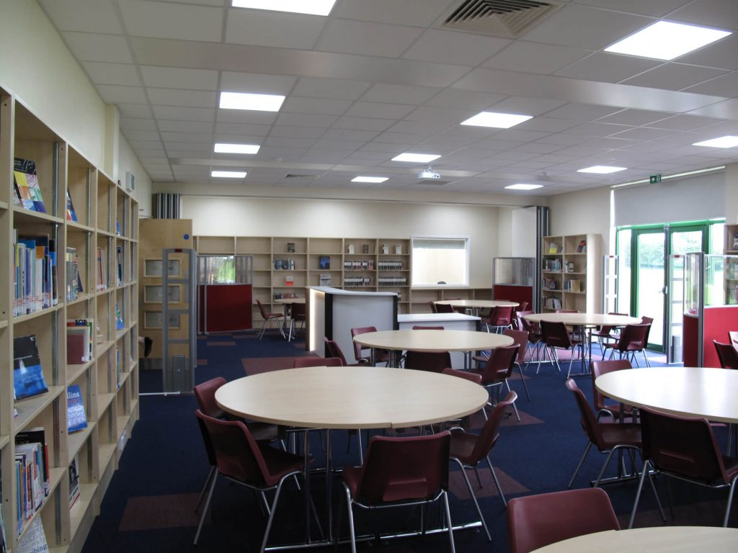
Hello and welcome to the sixth form study hub, my name is Mrs Midgley and I run the study hub room.
On average your timetable will show 3 supported study lessons which are all with me in the study hub classroom. They are lessons which you have to register for, like a normal lesson. The main difference is that you are expected to bring work from your subjects to this lesson. You could rewrite notes into mind maps, Cornell notes (see my link at the bottom of this page), pre-reading, practise papers and homework - the choice is endless. The idea is to improve your independent skills. At University you will have “non-contact/teaching time” and this gives you a flavour of how well you would cope when you are not being directed to work.
The study hub is a quiet place to study and not for social interaction. It is expected that for every hour of lessons you will need to work another hour on your own, so using your time wisely in school means you won’t need to take too much home. You must have a healthy work/life balance.
The study hub also has a wide range of text books from your lessons and wider reading to deepen your knowledge.
There are chrome books and PC’s available for you to use, but it is also advisable to bring your own device where possible.
Sixth form looks and feels different than Y11. You are expected to be more independent with your learning. Some of you might struggle with this and the transition into Y12 and I am here to help. I will get to know all of you in the first term, helping with learning how to study effectively so you get the most out of your time in Sixth Form. As I am in the study hub every day for every lesson you can come and speak to me if you have any worries or concerns and I will be able to help liaise with subject teachers or Head of Year.
My main piece of advice is to be ORGANISED! Get ready over the summer by making sure you have all the equipment you need for September. A4 ring binders for your notes, flashcards, highlighters and plenty of pens, a dictionary, a whiteboard and pens. In your transition work over the summer teachers have given you the specification from the exam board - print this out and start looking at it. Many subjects have given you wider reading suggestions so have a go at reading something that interests you. It’ll look good on your personal statement next year!
Here are some links to help you think about getting organised for next term.
Have a good summer and I look forward to meeting you next term.
https://www.youtube.com/watch?v=-Y1HJMuqAPY&t=26s
https://www.mindmeister.com/
https://quizlet.com/en-gb
https://www.youtube.com/watch?v=U9TNmomU7l0
https://www.youtube.com/watch?v=4AiXfFTkMNQ&t=39s
The Study Hub
Hello and welcome to the Sixth Form Study Hub, my name is Miss Willis and I run the study hub room.
This is where you will spend a proportion of your non-contact time and I’ll probably get to know most of you pretty well.
I’ve put together some information that I hope will help you to understand the study hub, my role and how I can help you with your learning.
Most of you will have three ‘supported study’ lessons which are all with me in the study hub. They are lessons which you have to attend, like a normal lesson. The main difference is that you are expected to bring work from your subjects to this lesson. You could rewrite notes into mind maps, Cornell notes (see my link at the bottom of this page), do some pre-reading, practise papers or homework - the choice is yours. The idea is to improve your independence skills.
The study hub is a quiet place to study and not for social interaction. It is expected that for every hour of lessons you will need to work another hour on your own, so using your time wisely in school means you won’t need to take too much home. You must have a healthy work/life balance. The study hub also has a wide range of text books from your lessons and wider reading to deepen your knowledge. There are chrome books and PCs available for you to use, but it is also advisable to bring your own device where possible.
Miss Willis’ Top Tips…
COMMUNICATE - As I am in the study hub every day for every lesson, you can come and speak to me if you have any worries or concerns and I will be able to help liaise with subject teachers or Head of Year.
Sixth form looks and feels different than Y11. You are expected to be more independent with your learning. This transition can be tricky but I am here to help!
Here are some links to help you think about getting organised for next term.
Have a good summer and I look forward to meeting you next term.
Be ORGANISED - Get ready over the summer by making sure you have all the equipment you need for September. A4 ring binders for your notes, flashcards, highlighters and plenty of pens, a dictionary, a whiteboard and pens.
Be PREPARED - In your transition work over the summer teachers have given you the specification from the exam board - print this out and start looking at it.
Many subjects may have given you wider reading suggestions so have a go at reading something that interests you. It’ll look good on your UCAS personal statement next year!
Mind Map Video
Study Skills – How to google better
Cornell Notes
Mindmeister – Online mind mapping
Quizlet
Ashlawn Sixth Form – Support and Opportunity

Slide 9
THE HABITS OF HIGHLY EFFECTIVE LEARNERS
1
7
7
2
7
6
3
5
4
1
They have a plan
There is a consistent pattern between students who are successful in sixth form and those who have a clear and realistic plan for their short or medium term future.
Few people have a long-term goal. Most of us change what we want to do BUT, we still perform better academically if we have some idea about what we’d like to do next. A short, medium or long term goal - having an idea for at least one of these is important. We can help you formulate your plan!
2
They strike a work / life balance
It can be difficult to find the perfect balance. Some people fall into a trap of socialising too hard and at the wrong times and kid themselves that this is part of their downtime. Many others fill every spare moment with study. Whatever you are doing, try not to be distracted by other things - this means no socialising whilst working but also, provided that you have done the hard work, don’t allow work to stop you from being happy - we always work better when we’ve got a healthy balance.
3
They learn how to manage their time
The school week is made up of 25 lessons. Of this, most sixth formers have 15 lessons of contact time, leaving 10 hours of non-contact time, not including lunch and break. It is vital that this time is used constructively for extra-curricular, super-curricular and study. Aside from it being the best opportunity to get work done and receive support from staff, utilising the ‘school day’ means you have less to do at home!
4
They regularly review
Sixth form qualifications, such as A-level and BTECs, often require you to apply your core understanding to different or unfamiliar contexts. This means that you must have a firm grasp of everything you are learning all the way through the course. Even spending ten to fifteen minutes per day reviewing the learning and making key points based on your learning from that day or week can help enormously in your understanding.
5
They communicate
Once a learner is comfortable in asking for help, they find that they make progress much more quickly and are less stressed in doing so - what you might call a ‘win-win’.
Don’t be embarrassed about seeking help – it is essential that you do!
6
They challenge themselves
You often hear about the ‘step-up’ from GCSE to sixth form studies.
To be successful ALL students need to challenge themselves to come out of their comfort zone and push for the top grades.
7
Understand that learning can be a struggle and it’s OK to fail
Your sixth form studies are the ‘Gold Standard’ of learning as they prepare you for employment, learning and life in a much more independent environment. They are supposed to be hard. BUT, if you put the effort in and take advantage of the support YOU CAN DO IT. When you have to work hard for something the reward feels greater!
Ashlawn Sixth Form – Support and Opportunity

Slide 10
G Suite
(Google Apps for Education)
As a school we use G Suite, which is a range of apps for education by Google. Some big advantages of this are that your work will save automatically, and you can access this work from anywhere if you log in with your google account that you have through school. These apps can be accessed from your PC. You can also download the apps onto your phone.
Gmail – Once you are set up with an Ashlawn email account. Many of your teachers will contact you via email if they need to talk to you about something so it is important that you check your emails every day. Notifications of homework or other resources posted by your teachers on google classroom will also come through email.
Google Classroom – Your teachers will post assignments, homework, and other resources for you here, so it is another essential tool to be familiar with. It also provides another place for you to have contact with your peers and/or teachers. The classroom app also contains a ‘to do’ list that will show all the assignment deadlines that you have coming up. This will help you to organise how you spend your time during study periods and at home.
Google Docs, Slides and Sheets – These are the Google equivalent to Microsoft Word, PowerPoint and Excel.
A great feature of these apps is that everything you do is automatically saved every few seconds so you will never lose any of your work. As with all the other Google apps, you can have more than one person working on a document at the same time. This is fantastic for working with peers on a group project or getting feedback from your teachers.
Google Keep – Google Keep is a very handy app to help you prioritise the tasks you have to do each week. You can create your own ‘to do’ lists and tick things off as they are done or write other notes/reminders for yourself. Ticking off an item will send it to the bottom of the list so you can quickly see how much you have already done and how much you still have to do.
Google Calendar – The Google Classroom apps link nicely with Google Calendar. All your classes will show up in Calendar automatically. You can also see which assignments are due on particular days. Additionally, you can schedule your own one-off or recurring events into the Calendar to help block out your time.
Google Drive – All of your Google documents get saved to Google Drive. You can create folders to help you organise your resources in here as well as view documents that your teachers or colleagues have shared with you.
Quizlet – This is not a Google app, however some of your teachers may use Quizlet to set short revision tasks
Ashlawn Sixth Form – Support and Opportunity

Slide 11
Super and Extra-Curricular
We believe that it is important that students develop personally as well as academically and we encourage our sixth formers to look at broadening and deepening their experiences. This could be in leadership, enriching their subject understanding, learning a new skill, being part of a team or just doing something because they enjoy it.
Here are some of the recent activities that students have taken part in.
Cooking on a budget
Sixth Form PE lessons
Sixth Form football team
Yoga
New driver awareness course
Interview skills
First aid course
Holiday Spanish
Mental health first aid course
Year 10 student mentoring
Academic mentoring programme
Volunteering
Work experience week
Sutton Trust summer programme
Pathways to law programme
Prefect opportunities
Student leadership team
Careers Fayre
Apprenticeships conference
Mock Interviews with employers
UCAS conference
University open days
Year 13 Prom
Ski trip to The Alps
Sports tour to USA
World Challenge
Taking part in essay writing competitions
Maths and Science Challenge events
Houses of Parliament trip
Ashlawn Sixth Form – Support and Opportunity

Slide 12
Top Tips
1
Follow the Sixth Form Instagram and Twitter or the School Facebook page for regular updates.
Take advantage of the resources in the Study Hub and the Library.
Strike a work-life balance.
It is important to make sure that you make time for yourself and the things that make you happy!
Ask for help early if you are stuck, whether it be subject related or personal, there is plenty of support for you.
Bring an electronic device with you each day. Teachers will share work and resources with you online.
A part-time job can be a great opportunity to learn new skills and give you a bit of extra money but be careful not to work too many hours or your studies will suffer!
Get into the habit of using your time in school for study. This will keep you on top of your workload and lighten the need for you to work at home.
Sixth form study requires you to develop as an independent learner. Read beyond the specification of your course to strengthen your understanding.
Get yourself into good habits early!
Be organised, look back over previous notes regularly to recall and strengthen your understanding.
Seek out Super-Curricular opportunities. These look really good when you apply to university and they help develop your subject knowledge too!
Start to think about your options for Post-18 choices early.
Use our website to help you research and make plan.
Ashlawn Sixth Form – Support and Opportunity

Slide 13
Rules and Expectations
Students are strongly encouraged to bring an electronic device to school, in addition to their mobile. Phones are only allowed in designated 6th form areas. The purpose of personal devices at school is to support learning; organisation, note-taking, independent study etc. Student access to the Ashlawn wireless network will be regarded as a privilege and not an entitlement. All use will be monitored by the ICT Support team Electronic devices can be used in lessons to support learning with the member of staff’s permission. There will be sanctions in place for the misuse/ disruption to learning if the device is used inappropriately.
Independent study periods will be allocated to your timetable. These periods need to be used for study, i.e. homework, revision or pre-reading. You will have the option to work in the Library, in the Sixth Form Study Centre, on PCs in the mezzanines in Sixth Form or in the study zones in the canteen.
Study frees should always be used for study
Attendance is key!
Ashlawn’s minimum attendance figure is 95%; to fall below this you would be missing half a day a fortnight.
In most cases, if your attendance falls below our expectation, school procedures will be put in place, e.g. contacting home, attendance report, compulsory independent study in place of independent study periods etc.
No smoking/vaping is permitted on site or in the near vicinity. Students are also not permitted to bring any smoking-related paraphernalia into school We have a strike system for anyone caught breaking the smoking rules. Ultimately, this can result in exclusion.
You must remain on site during the school day, i.e. between 8:45 am and 3.20 pm. Try to arrange appointments outside of these times, if possible. Students are only permitted to be absent to attend a driving exam, not driving lessons.
We recommend that students with part time jobs work a maximum of 10 hours per week.
Ashlawn Sixth Form – Support and Opportunity

Slide 14
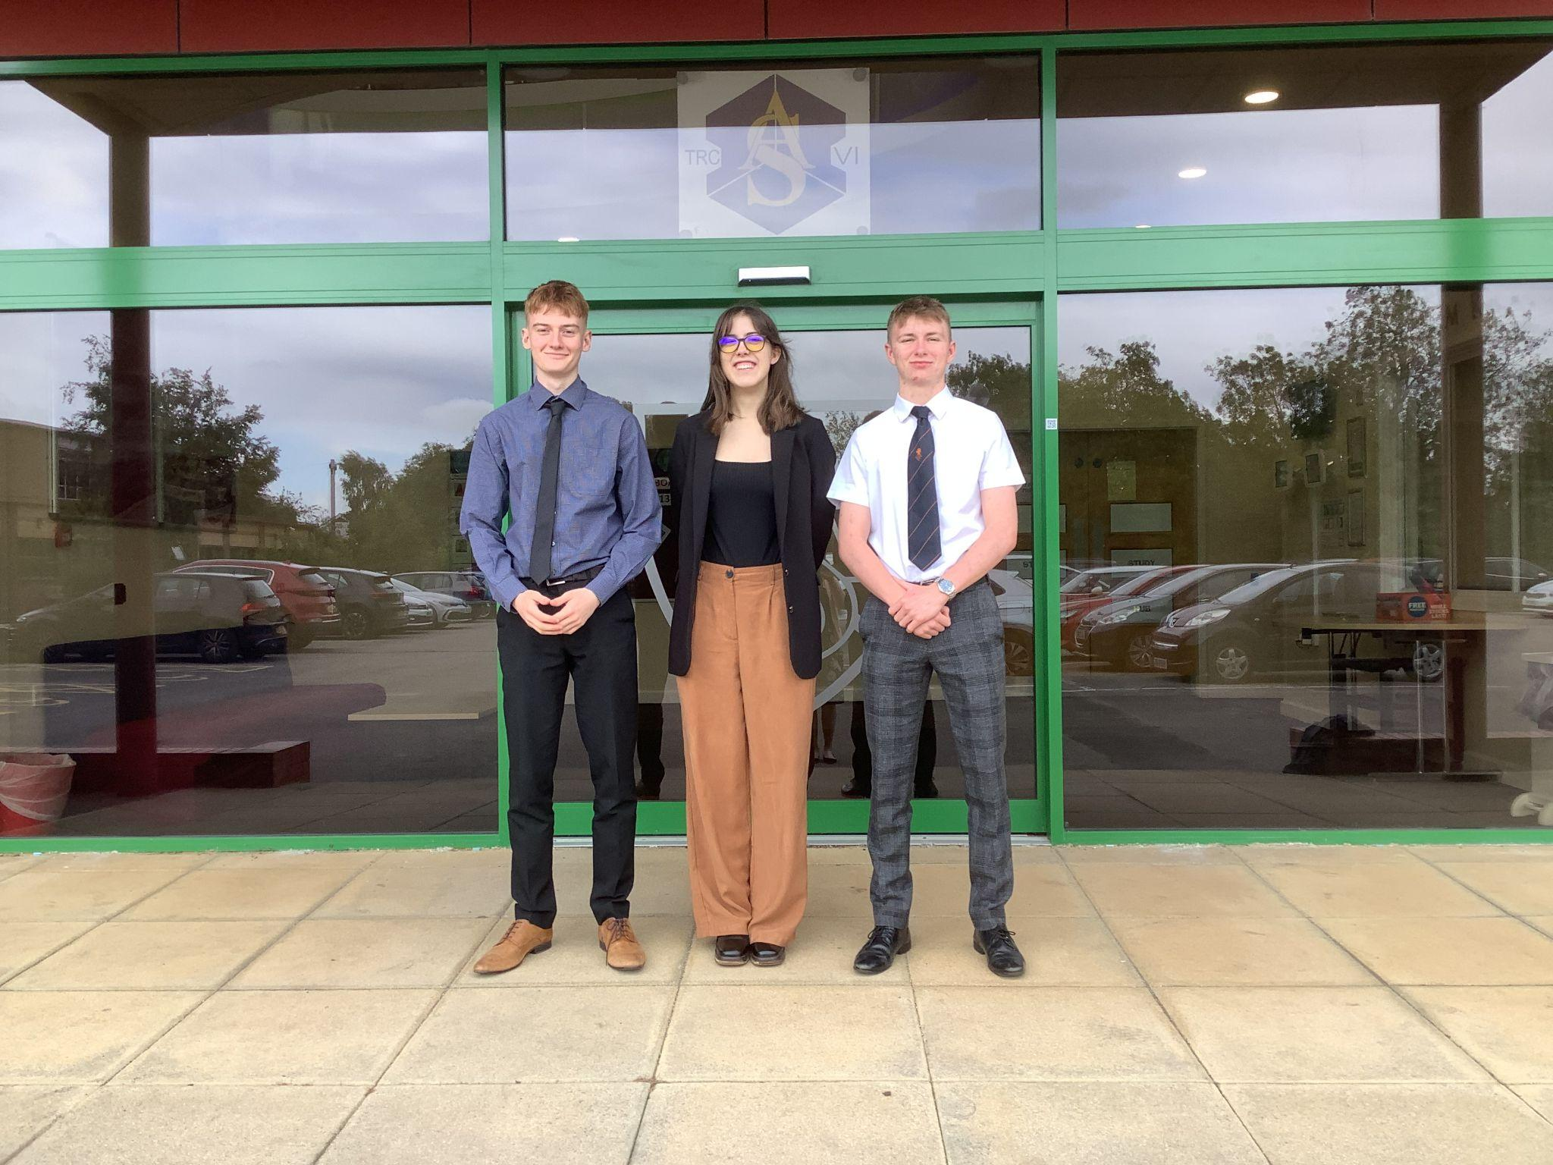
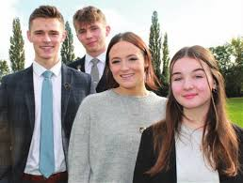
Student Dress Code
Our gender-neutral dress code is ‘traditional office’ wear. All students are required to wear a suit with smart leather or leather-look shoes.
YES PLEASE
Smart trousers, dress or skirt with optional suit jacket
Any tailored dress / skirt should be no more than 3” above knee
Trousers should be tailored – no denim
Smart shirt / blouse or smart office-style round neck top of a sensible cut
A button up shirt must be accompanied by a tie or bow-tie
Optional jumper or cardigan should be fine knit
Office shoes, court shoes, dolly shoes, short office-style boots, smart sandals
Light, subtle make up
Hair colour and style must be appropriate for school
Clear nose stud only
NO THANK YOU
No extreme hairstyles, unnatural hair colour
No facial piercings, ear stretchers, tongue piercings, visible tattoos
No patterned tights
No denim
No trainers/converse
No strappy tops
No chunky knit cardigans
No hoodies or sweatshirts
LADIES DRESS CODE
YES PLEASE
Tailored dress / skirt 3” above knee
Smart shirt / blouse or smart office-style round neck top of a sensible cut
Fine knit jumper / cardigan / jacket
Tailored trousers – no denim
Court shoes, dolly shoes, short office-style boots, smart sandals – NO TRAINERS
Light subtle make up
Hair colour and style must be appropriate for school
Clear nose study only
NO THANK YOU
Extreme hairstyles, unnatural hair colour
No facial piercings, ear stretchers, tongue piercings, visible tattoos
GENTS DRESS CODE
YES PLEASE
Suit trousers and suit jacket
Office style shirt with collar and tie that must be visible
Fine knit smart jumper / cardigan
Tie or bow tie must be visible at all times
Smart jacket or blazer – no denim
Plain leather shoes or boots – NO TRAINERS
Hair colour and style must be appropriate for school
Clear nose studs only
NO THANK YOU
Extreme hairstyles, unnatural hair colour
No facial piercings, ear stretchers, tongue piercings, visible tattoos
Ashlawn Sixth Form – Support and Opportunity

Slide 15
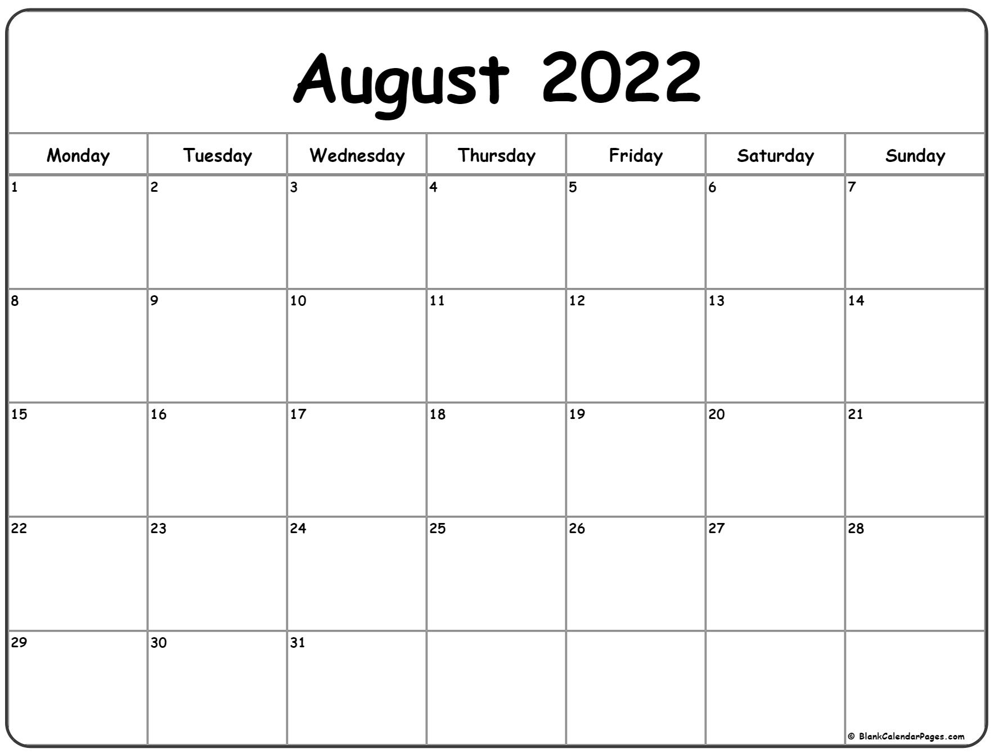
GCSE Results Day / Enrolment Day
Thursday 24th August is still the official GCSE results day and it is also the day that enrolment begins for sixth form at Ashlawn.
It is now time to confirm your place and the courses that you want to study in September.
Hopefully, you’ve done well and are looking forward to starting the courses that you chose earlier this year.
But, things change, and you may decide that you want to follow a new path with different subjects or perhaps you haven’t quite got the grade you needed and want to discuss your options. Here is everything you need to know about your enrolment.
24th August – GCSE results day.
If you are an Ashlawn Student, you will be able to pick your results up at your designated time slot. If you have received the results you need to do your chosen courses then all you need to do is complete the confirmation slip and hand it in. If you haven’t quite got the grades you need, or you want to make a change, the Sixth Form team will be available in the Sixth Form Centre to discuss your options and ensure you are on the right course.
If you are an external applicant, your current school will have their own arrangements for collecting GCSE results. Once you have got these you will need to come to Ashlawn to confirm them with us. We will have a team of staff on hand to check these. If you have the grades you need, this won’t take long. If you haven’t quite got what you needed, or if you want to make changes, you can arrange an appointment to speak to one of the Sixth Form team about your course choices.
It is a very important day as it is vital that students do courses that they enjoy and are right for them – both in terms of their future choices and their academic skillset. You need to be ambitious but also realistic – some subjects are very demanding academically and you want to choose a manageable selection of courses.
We also allow students to have a say in what tutor groups they might like to be in to make sure that the transition is as smooth as possible. On Enrolment day you can let us know of any preferences.
WE LOOK FORWARD TO SEEING YOU IN SIXTH FORM SOON
Ashlawn Sixth Form – Support and Opportunity

