Slide 1
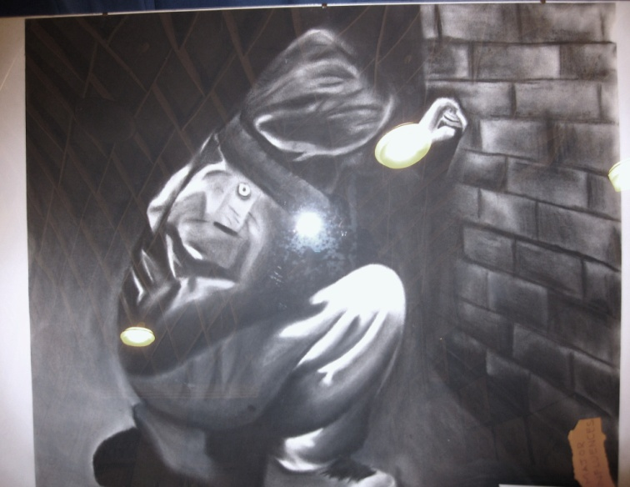
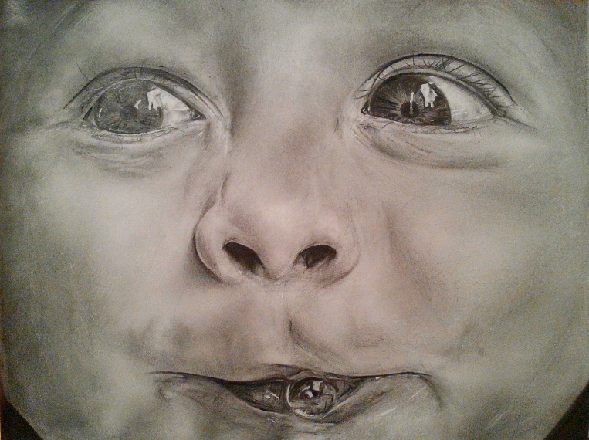
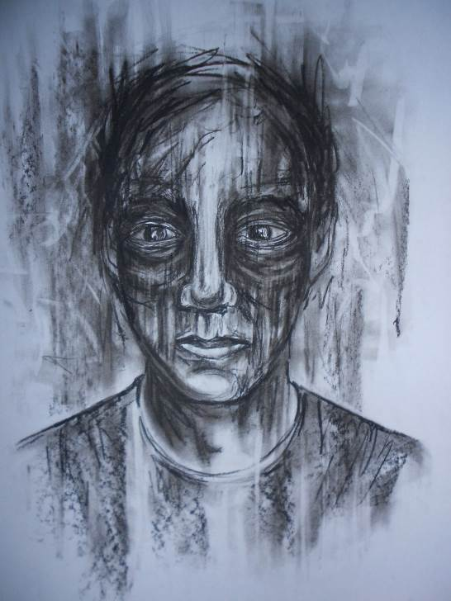
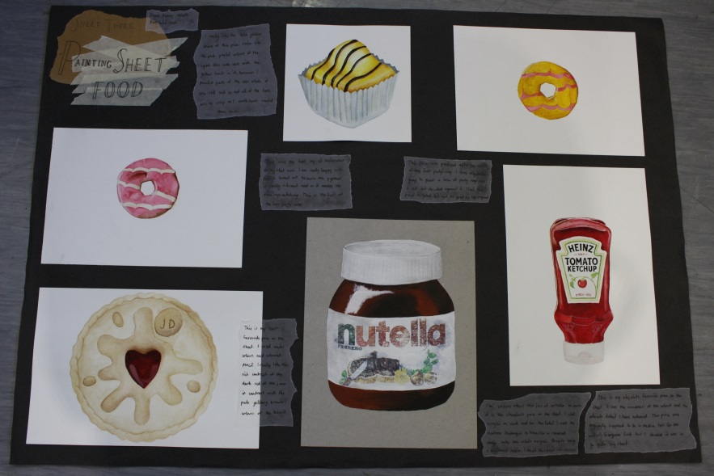
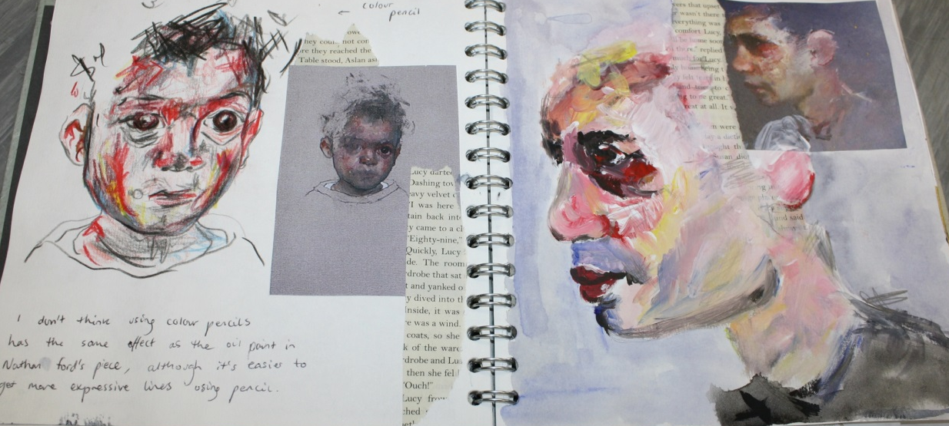
A Level Art & Design
Introduction to the course and – Pre Sept work

Slide 2
Details
Title of qualification
A Level Fine Art
Exam board and specification used
AQA
Copy of the specification
https://www.aqa.org.uk/subjects/art-and-design/as-and-a-level/art-and-design-7201/specification-at-a-glance

Slide 3
What to do- before september starts
You need to buy:
A3 or A4 sketchbook (spiral bound, hard backed)
pens, pencils and paintbrushes etc. Any other specific specialist equipment you may like.
Label your sketchbook neatly on the front cover:
Unit 1: Personal Investigation
A Level Art
Your Full Name (Birth Name on the school registers)
Ashlawn School
TASKS:
Create an initial title page called: “Transition to A Level Art” Decorate this and make it a work of art in its own right. It is the first page in your sketchbook and should show case your strength. First impressions last to the moderators.
Do 6x pages of sketches (drawing from observation)) using a variety of media. Take your book out with you and draw some interesting things: Ideas: people, places and objects
work into these pages with: Collage, watercolour, annotation the pages.
Research 3x artists (any artists) in 3x separate media. Present facts, your interpretation of the work, images of their work and your own sketches/ swatches inspired by them on 1x double page spread per artist.
Visit 1x gallery or exhibition. Title the page “My visit to….” and write about it. Take lots of photos and stick these in your book. you may also include: Pamphlets, postcards etc.
Any questions then please do not hesitate to contact the Art and Photography department- (eburnec@ashlawn.org.uk

Slide 4
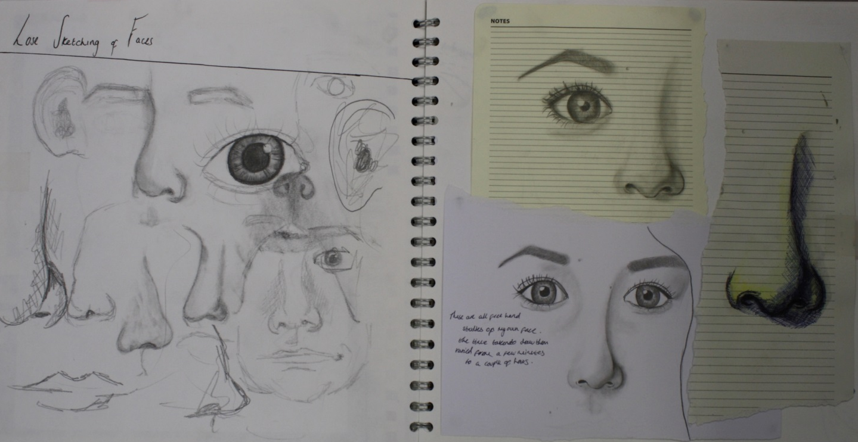
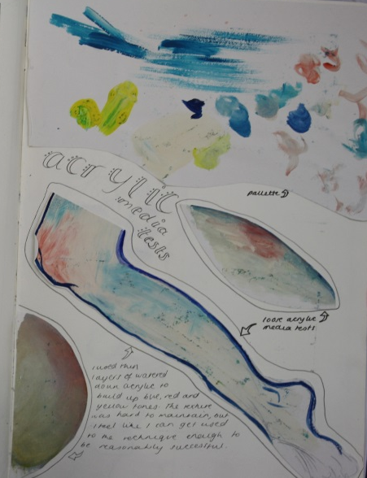
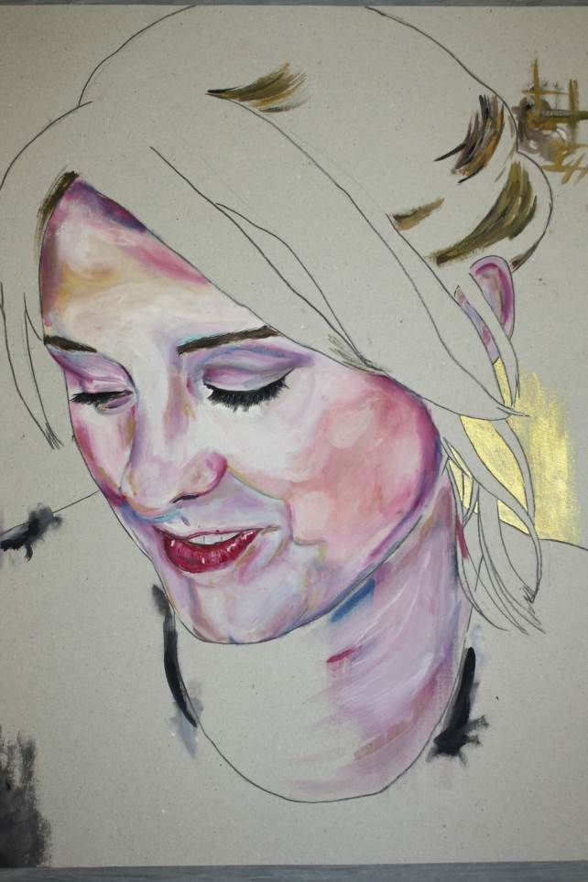
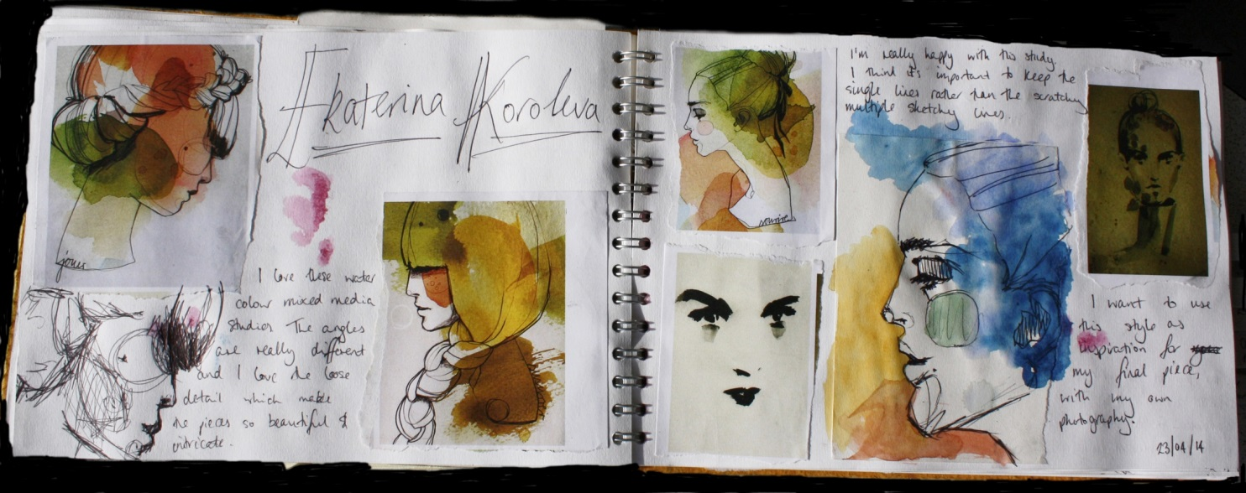
Examples of sketchbook layout and work

Slide 5
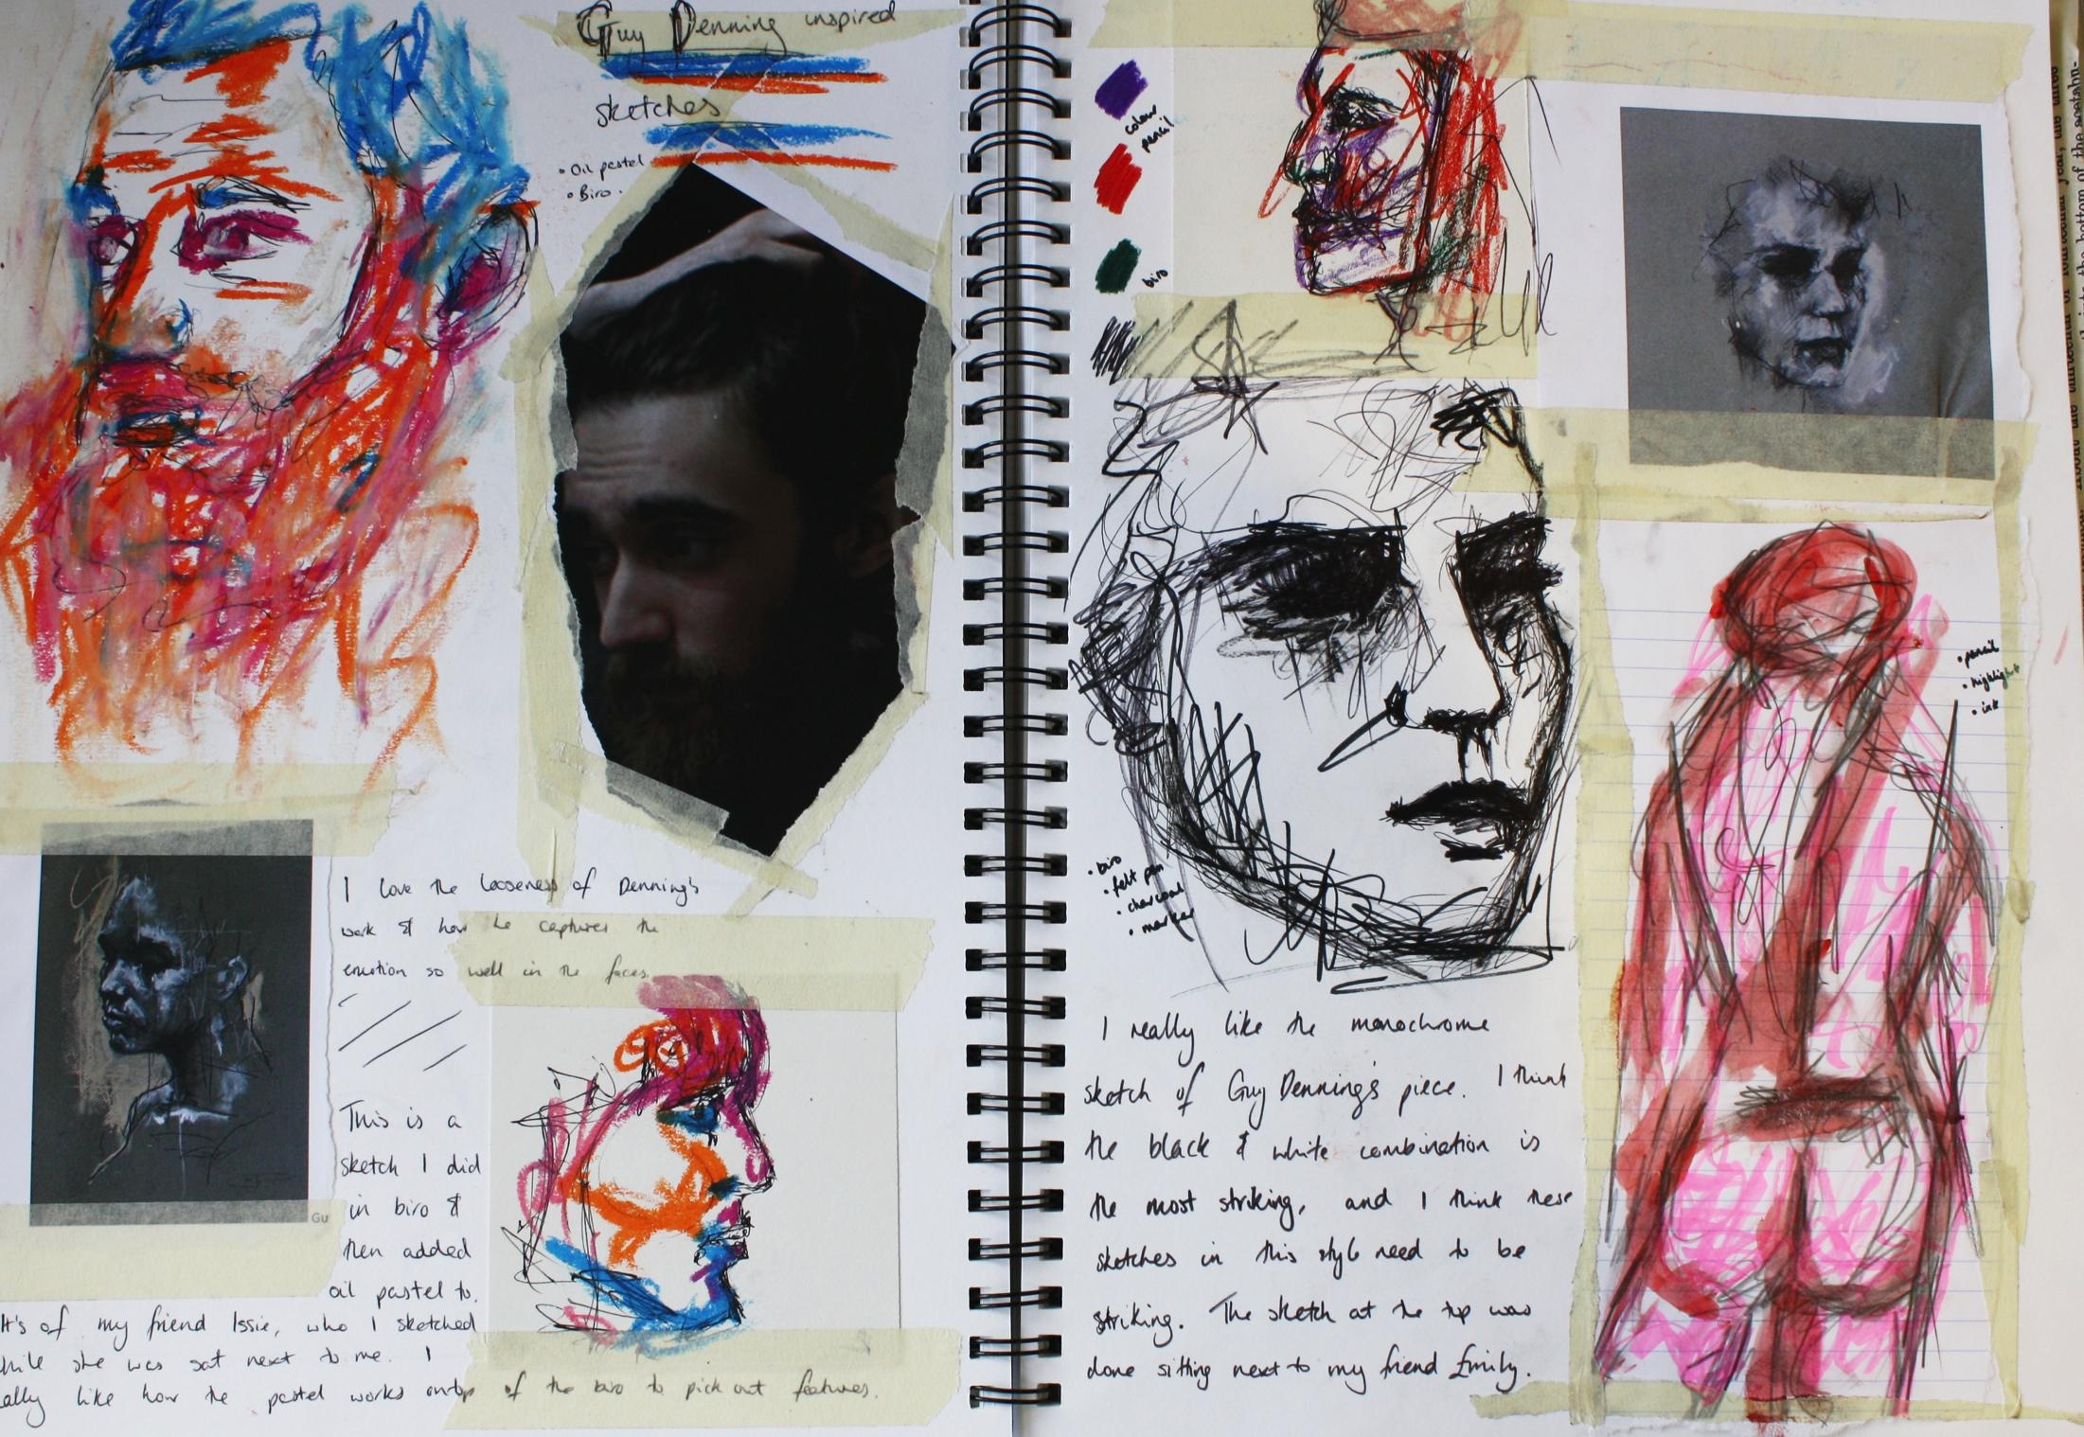

Slide 6
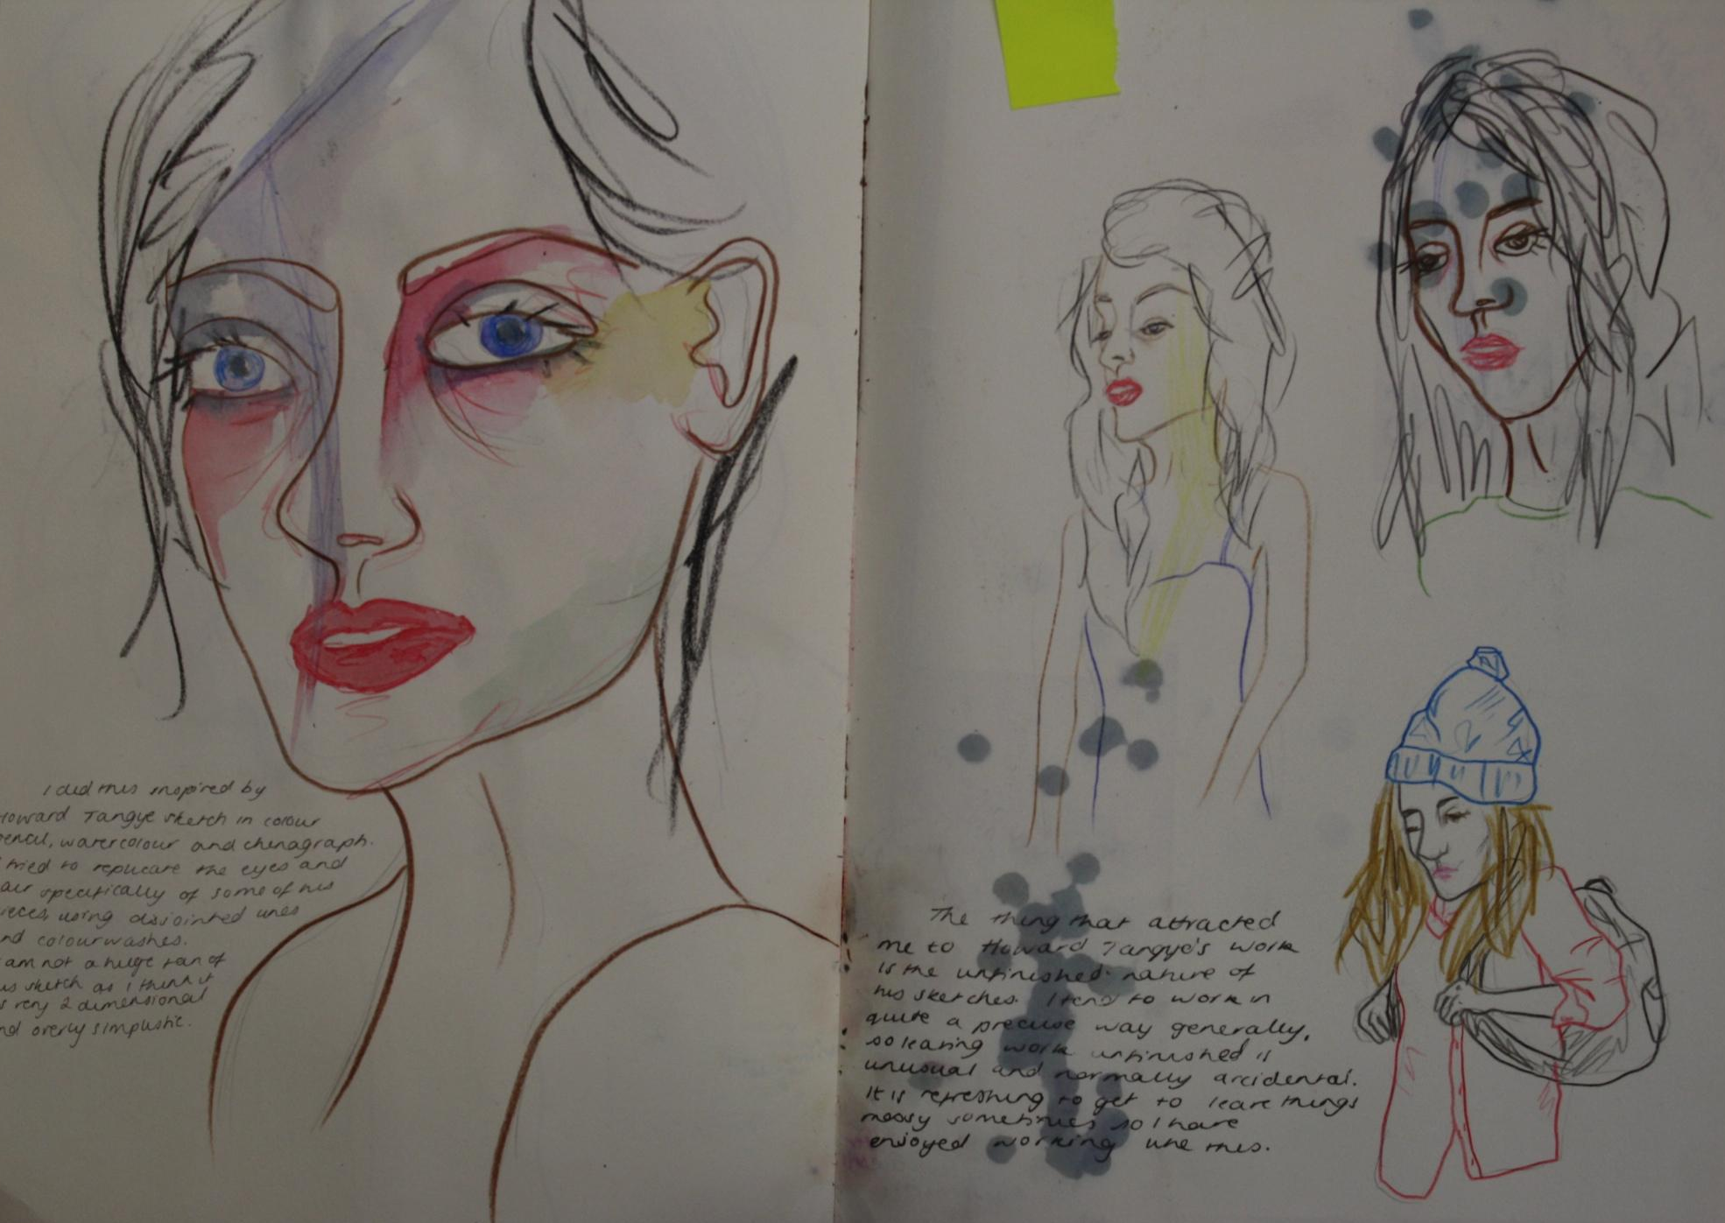

Slide 7
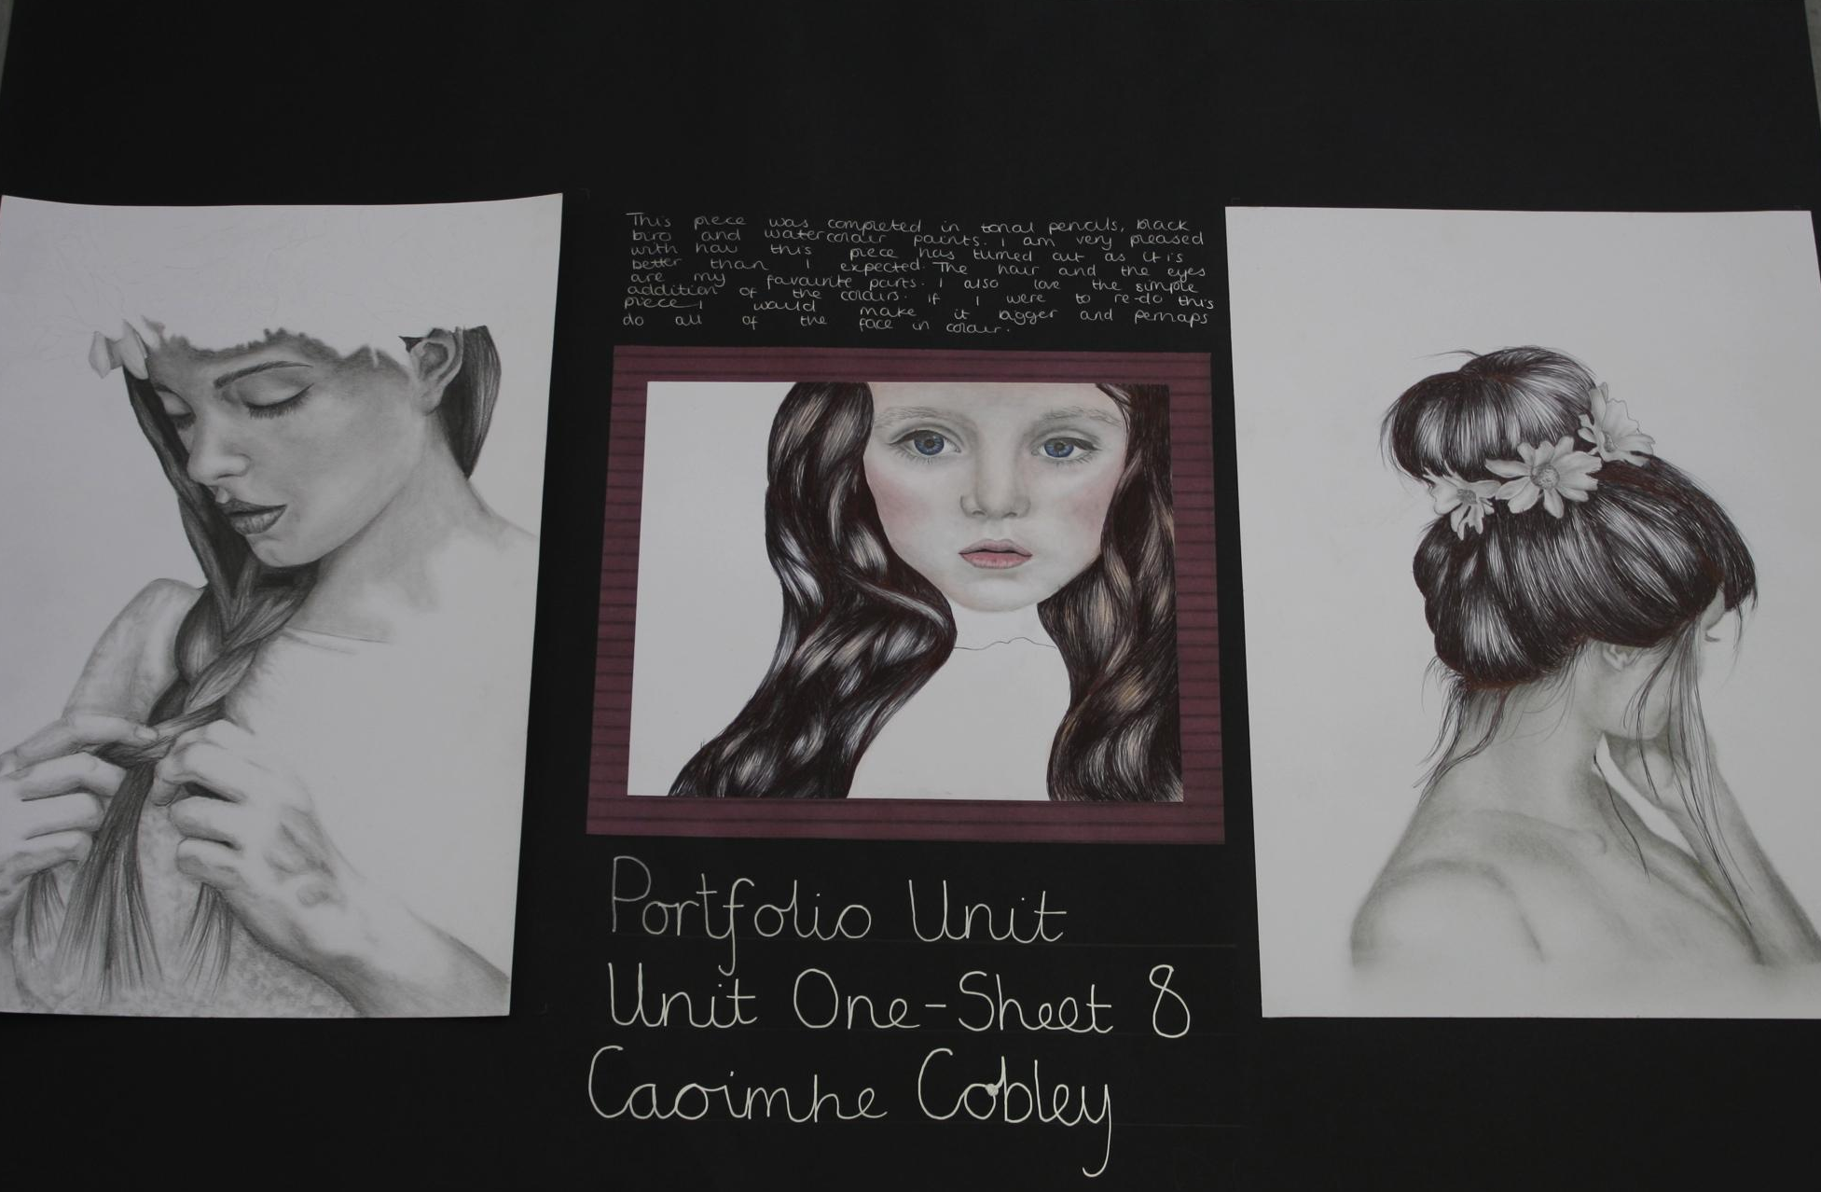
Your sketchbook is the task you will be doing for the first term in September so you need to understand how it works for you and begin now. Use the previous photos to help guide you.
An example an A1 sheet of ‘sustained art work’- the best of the best you can do. This is what you will produce in the second and third term next year

Slide 8
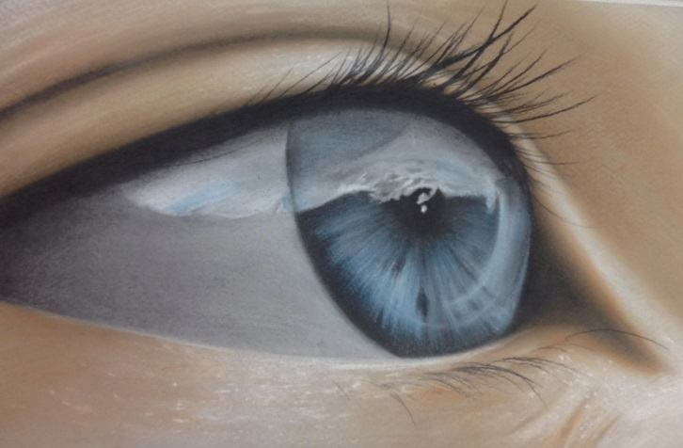
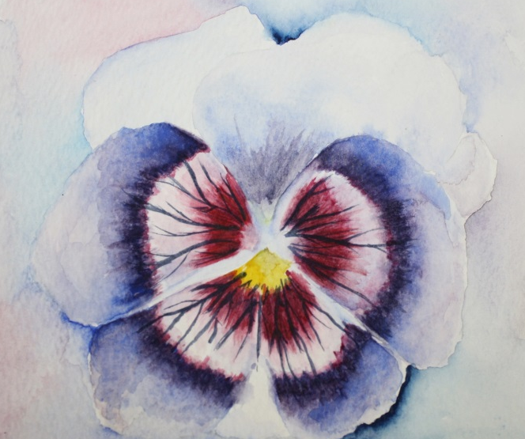
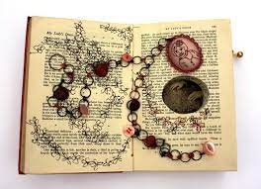
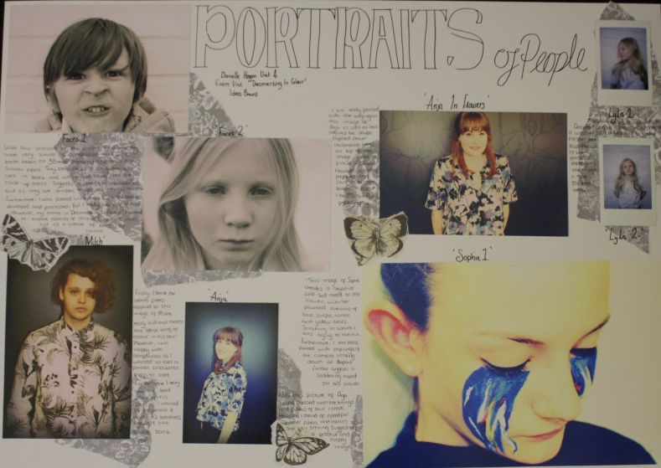
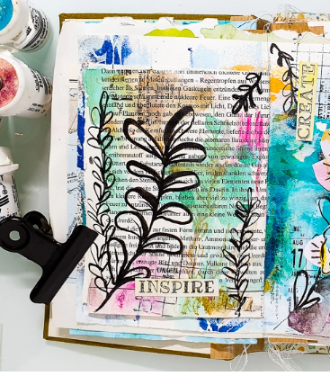
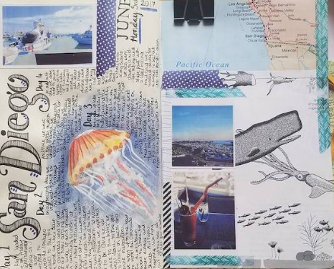
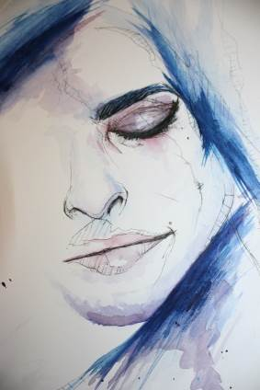
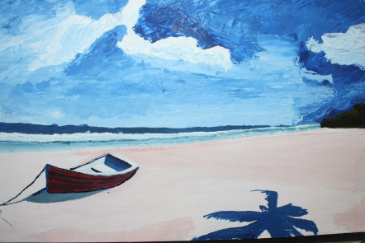
Photos to inspire

